Slide 1
INDUSTRIAL ENGINEERING OPERATIONS AND MANAGEMENT
STUDENT CHAPTER
SAMPOERNA UNIVERSITY
2020-2021

Slide 2
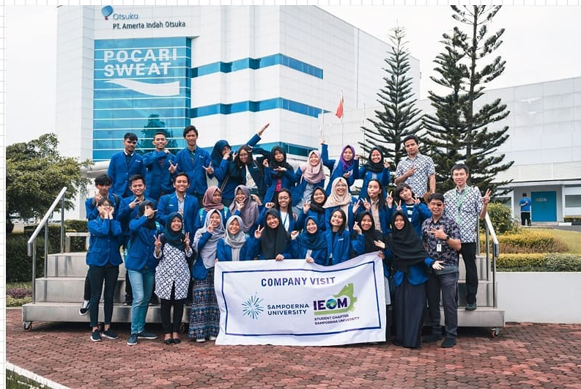
PERIODE 2020/2021
IEOM
INDUSTRIAL ENGINEERING &
OPERATIONS MANAGEMENT
IEOM is an international organization that provide communication and networking among diversified people.
We as IEOM Student Chapter of Sampoerna University through this platform, ensure to enhance the softskill and hardskill among IEOM members in the field of industrial engineering and operations management.

Slide 3
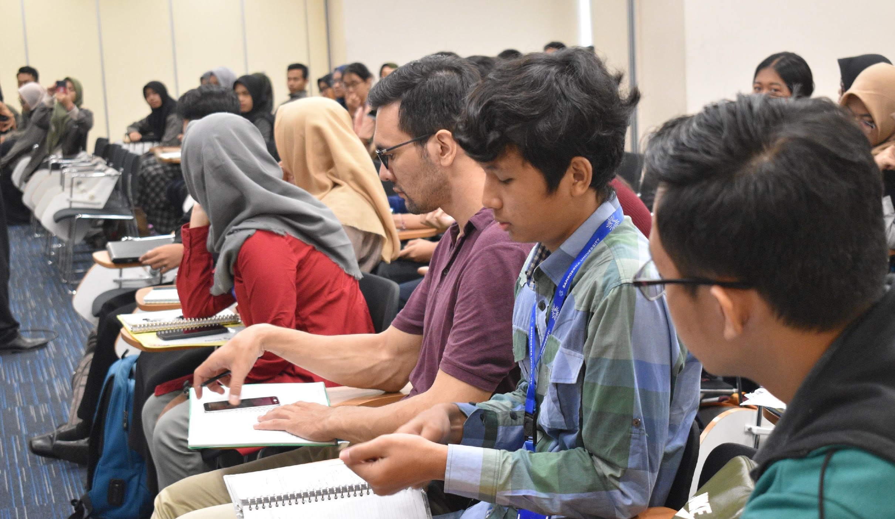
PERIODE 2020/2021
VISION
IEOM
Being a place for engineering students to develop their potentials in the field of technology development and quality of human resources to become more active, and innovative.

Slide 4
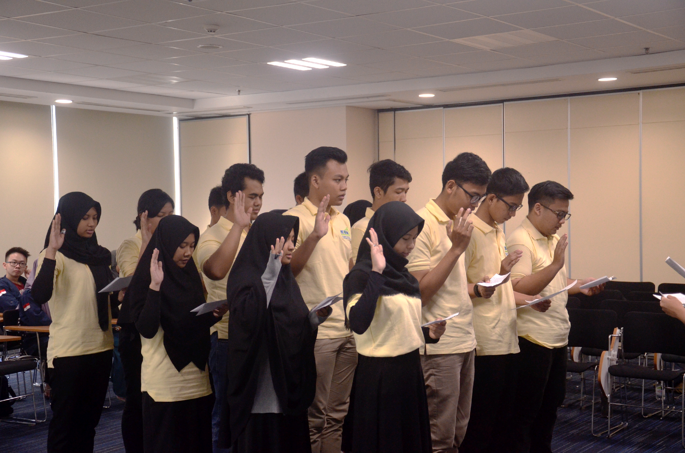
PERIODE 2020/2021
MISSION
IEOM
To be a shelter for the IEOM Student Chapter family in Sampoerna University
To create events to bond, develop, and guide industrial engineering students
To introduce IEOM Chapter Sampoerna University and collaborate with other campuses around Indonesia

Slide 5
OFFICERS
ADVISOR
IEOM
Surya Danusaputro Liman Ph.d
PERIODE 2020/2021
PRESIDENT
VICE PRESIDENT
Stephen
Indah Riantantri M
SECRETARY
Elsa Rahma Febriani
PROGRAM
FINANCE
MEMBERSHIP
CREATIVE DESIGN
PUBLIC RELATION
Adhima Ratnaningtyas
Marianne Helga Moniaga
Yayang Nadistya Ayu
Muh Ikhsan
Sandy Buvinda
Ahmad Maulana Ibrah
Jason Dharma
Ayu Widya Astuti
Sayunda Nara Aulia
Martinus Rivaldo W.
Restu Maha Dewi
Wahyu Oktarizaldi
Nafadza Salsabila R.
Lazuardi Fauzan P.
Andrea Aurielle
Tamma Irawan
Annisa Ghina

Slide 6
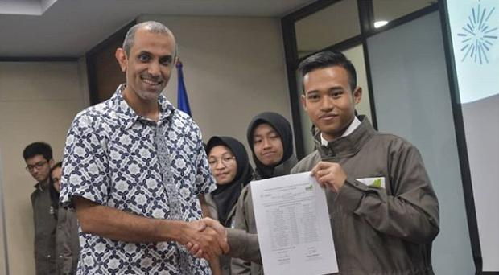
PERIODE 2020/2021
EVENT
IEOM
This event aims to authorize the new position of IEOM SU 2020. This event is also to introduce IEOM’s Program for 2020/2021 to the student of IE.
1
Induction Ceremony

Slide 7
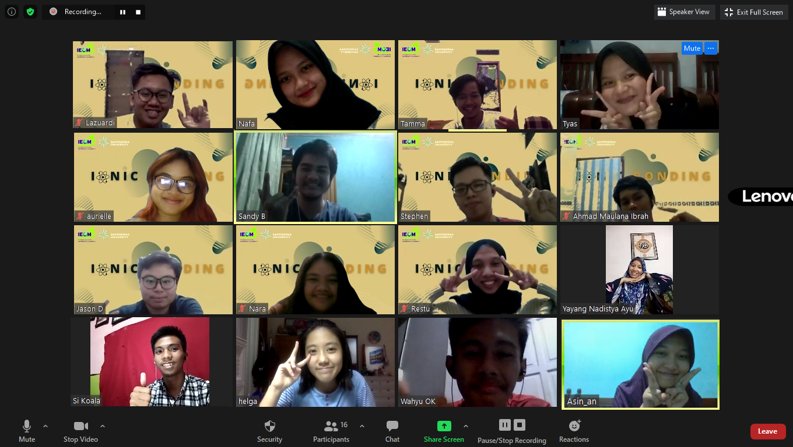
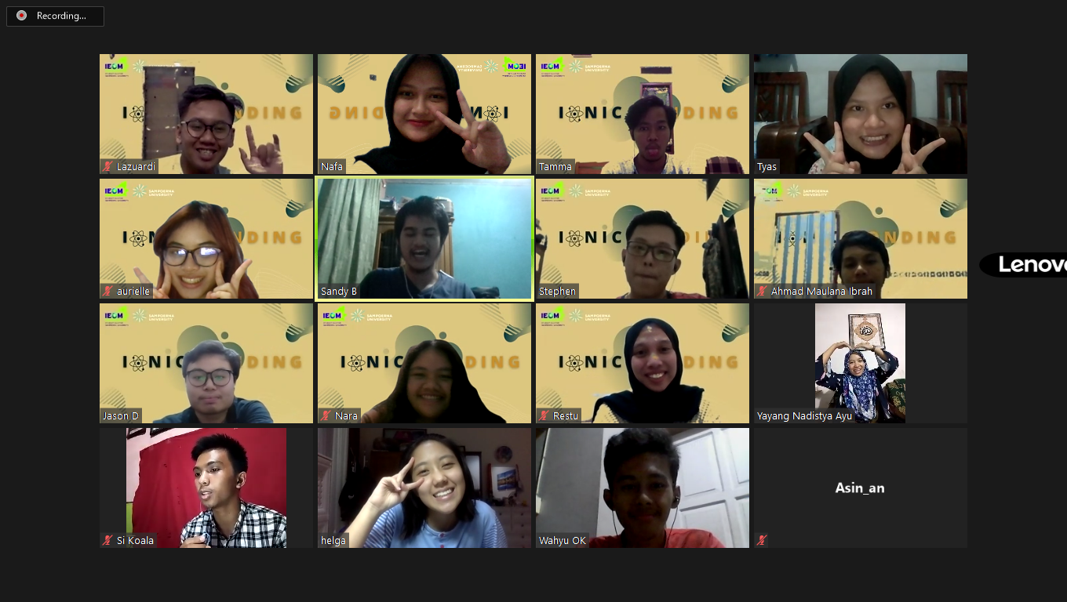
PERIODE 2020/2021
EVENT
IEOM
This event aim to build and strengthen the bonding among IEOM SU officers.
2
Ionic Bonding

Slide 8
PERIODE 2020/2021
EVENT
IEOM
This event held by IEOM to strengthen relationship among the IE members with lecture, since IEOM presents as a Student Association for IE students in campus.
3
IE Gathering

Slide 9
PERIODE 2020/2021
EVENT
IEOM
Capacity Building is an event which includes inspiring talk that help student to improve their skill sets and knowledge they need to compete as future industrial engineers.
4
Capacity Building

Slide 10
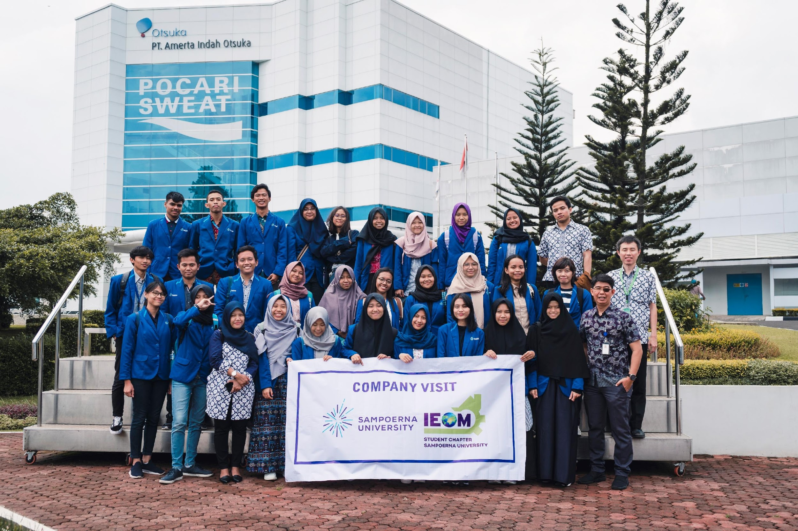
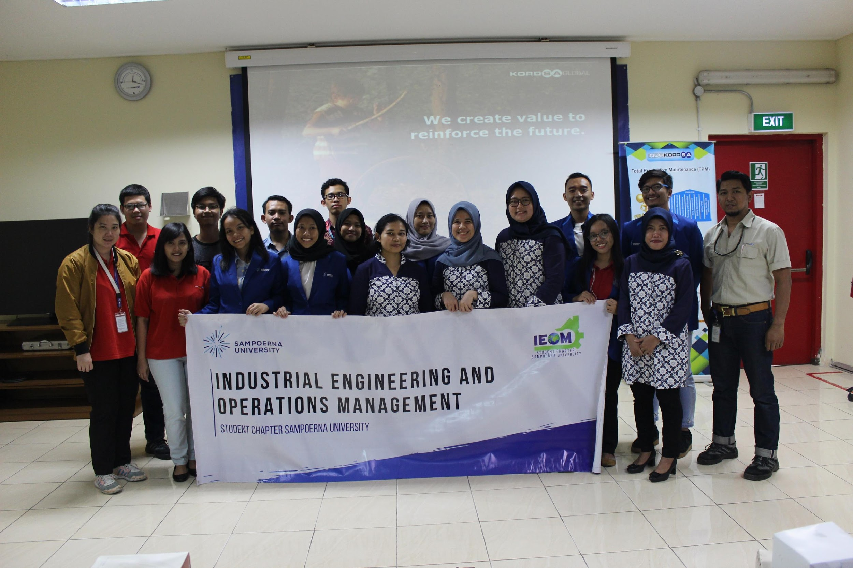
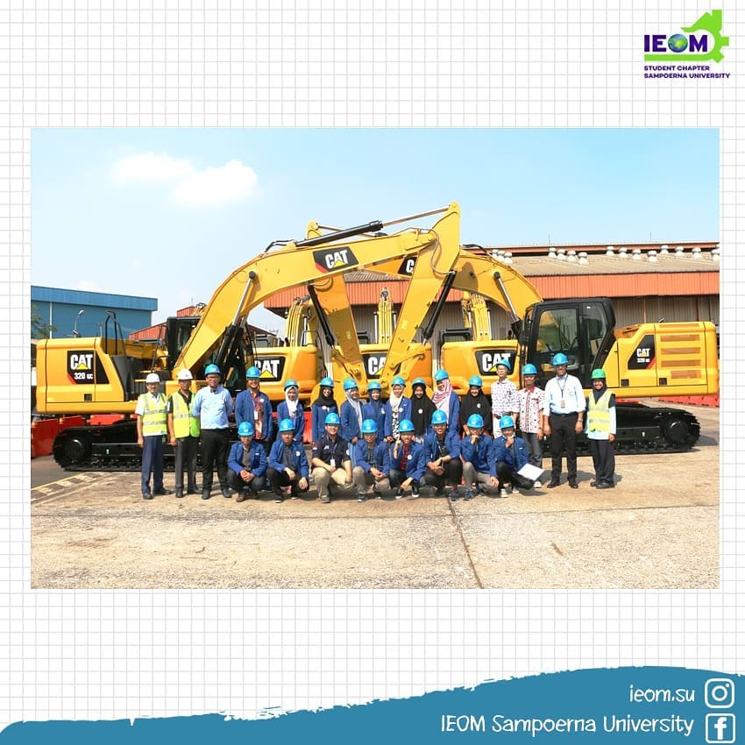
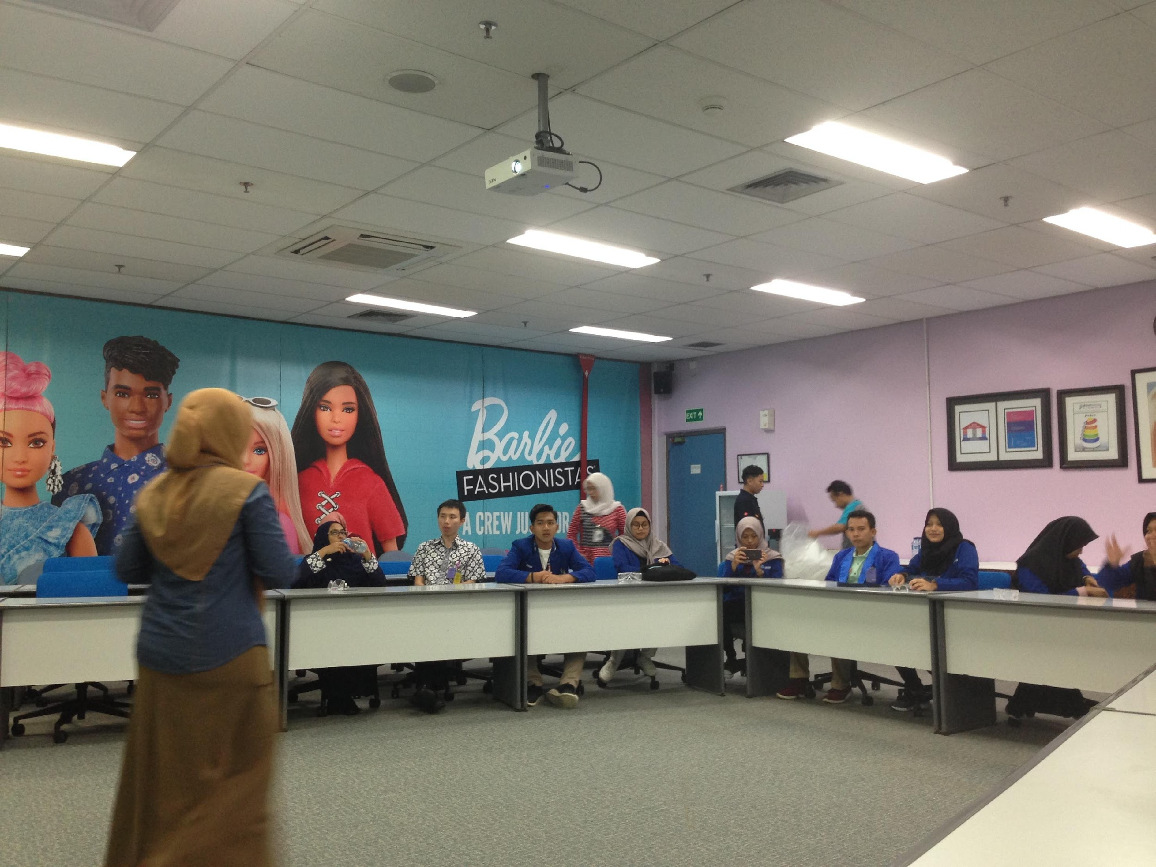
PERIODE 2020/2021
EVENT
IEOM
Company visit helps students to get familiar with company’s system and real life application of what they have learned in the class. This event also give the opportunity for students to learn from the professional engineers.
5
Company Visit

Slide 11
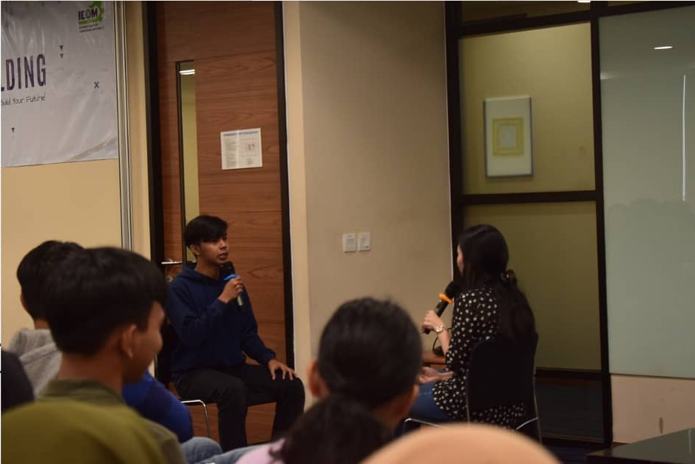
PERIODE 2020/2021
EVENT
IEOM
IE talkshow is an event which includes talk show with several professional speaker that view the theme from multidisciplinary perspective.
6
IE Talkshow

Slide 12
PERIODE 2020/2021
EVENT
IEOM
This competition will be held online. We conduct this event as a campaign to practice creativity and graphic design, also to raise the awareness of the importance of sustainable life in engineering.
7
IE Competition

Slide 13
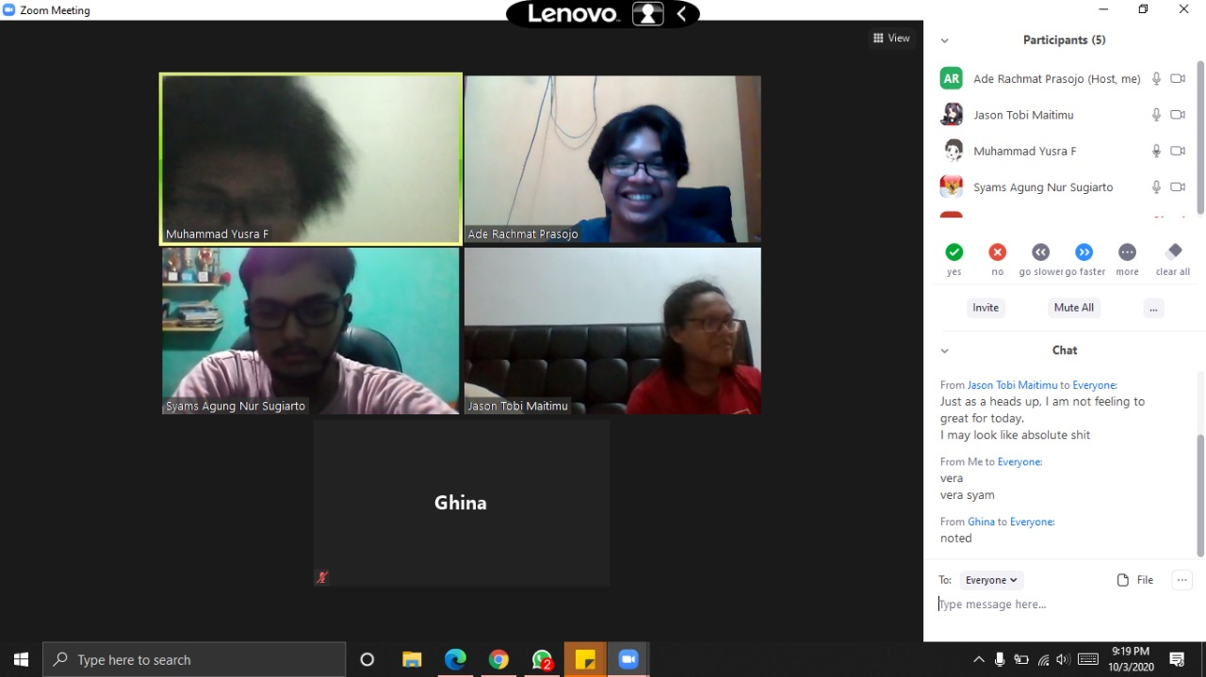
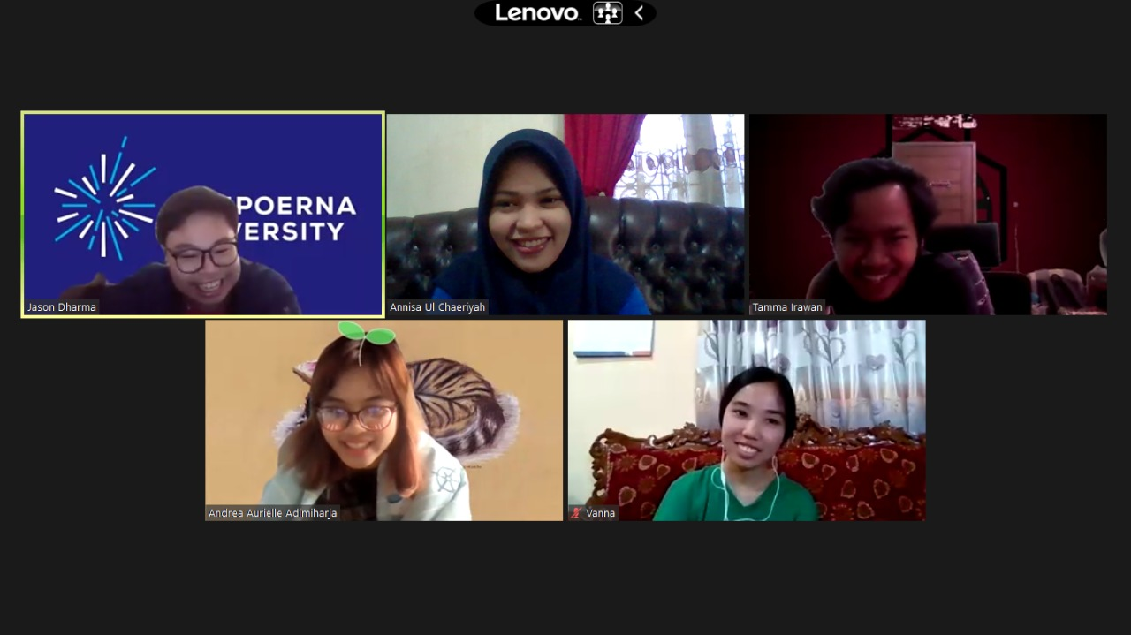
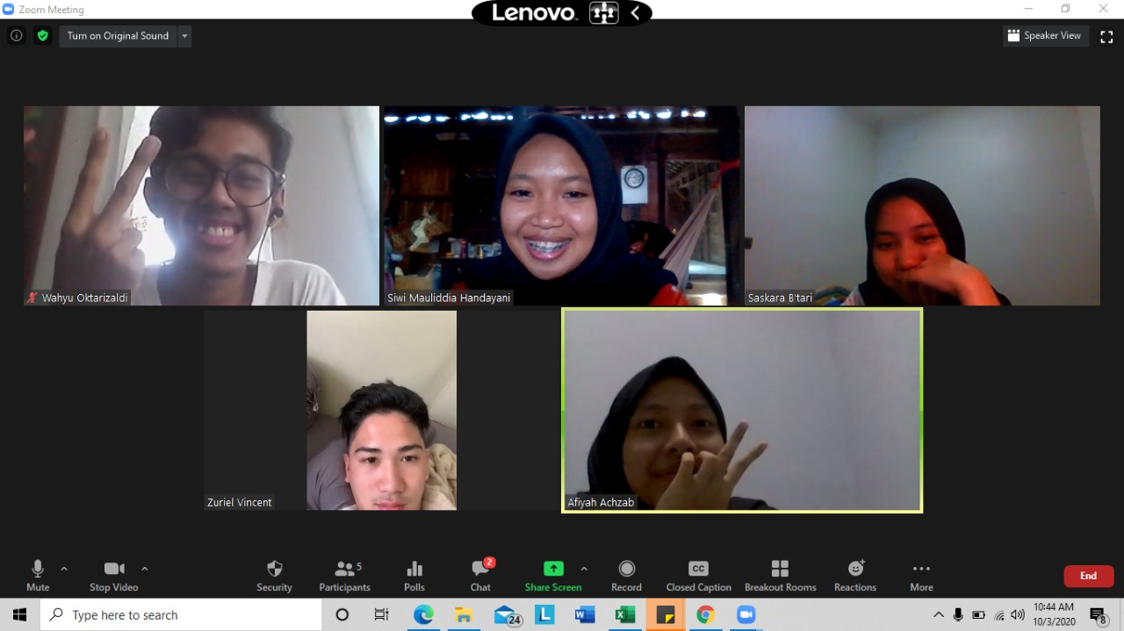
PERIODE 2020/2021
EVENT
IEOM
Sharing session that held by IEOM - SU to create an bonding and awareness about college life and industrial engineering.
8
Mentoring

Slide 14
PERIODE 2020/2021
1
3
5
TIMELINE
Ionic Bonding
12/09
Capacity Building 1
24/10
IE Company
Visit
27/11
IEOM
September
October
November
Induction Ceremony
17/10
IE X BC Talkshow
07/09
IE Competition
22/11/ -----
2
4
6
2020

Slide 15
PERIODE 2020/2021
6
8
TIMELINE
IE Competetion
--- 22/01
Capacity Building 2
19/02
IEOM
November
December
January
February
March
IE Gathering 1
21/12
IE Gathering 2
20/03
7
9
2021

Slide 16
PERIODE 2020/2021
GET IN
TOUCH
IEOM Chapter Sampoerna University
ieom@my.sampoernauniversity.ac.id
ieom.su
WEBSITE: http://ieomsociety.org

